Slide 1
Lecture 16:
Dynamic Timing Analysis
Patrick Schaumont

Slide 2
Dynamic Timing Analysis
Simulation is used extensively in a digital design flow for verification
Since this simulation is a timed simulation, we may as well try to use intermediate design representations as simulation targets
  The lower-level synthesis blocks are still pin-compatible with the RTL top-level
  Hence, the same simulation testbench can be used

Slide 3
Dynamic Timing Analysis
Constraints
RTL Verilog
Testbench
Mapper
Post Map
Netlist
Testbench
Place and
Route
Post P&R
Netlist
Testbench
Bitstream
Generation

Slide 4
Dynamic Timing Analysis
requires
simulation
library
RTL Verilog
Post Map
Netlist
Netlist in terms of FPGA components
no logic delay (functional simulation)
Post P&R
Netlist
Netlist in terms of FPGA components
logic delay and wire delay included

Slide 5
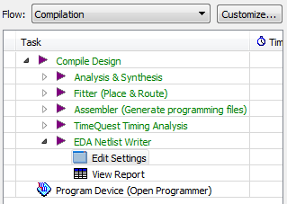
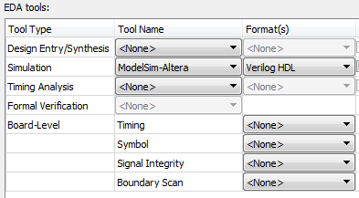
Synthesis and Simulation are integrated
Quartus
(synthesis)
external
simulator

Slide 6
How does a post-synthesis netlist look like?
// Location: LCCOMB_X38_Y53_N12
cycloneive_lcell_comb \q[6]~76 (
// Equation(s):
// \q[6]~76_combout = ..
// \q[6]~77 = ..
.dataa(\q[6]~reg0_q ),
.datab(\a[6]~input_o ),
.datac(gnd),
.datad(vcc),
.cin(\q[5]~75 ),
.combout(\q[6]~76_combout ),
.cout(\q[6]~77 ));
// synopsys translate_off
defparam \q[6]~76 .lut_mask = 16'h698E;
defparam \q[6]~76 .sum_lutc_input = "cin";
// synopsys translate_on
dataa
datab
datac
datad
q1[3]
0
0
0
0
0
1
0
0
0
1
6
0
1
0
0
1
1
1
1
0
0
0
0
1
0
1
1
0
1
0
0
9
0
1
1
0
0
1
1
1
0
1
0
0
0
1
0
1
0
0
1
0
0
1
0
1
0
8
1
1
0
1
1
This is a component
from an FPGA
simulation library.
0
0
1
1
0
1
0
1
1
1
0
1
1
1
1
E
1
1
1
1
1

Slide 7
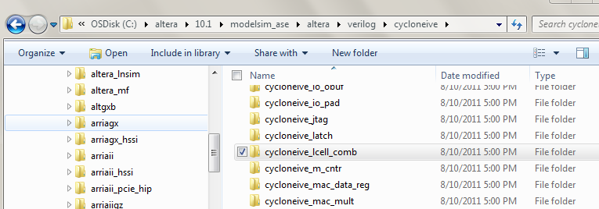
cycloneive_lcell_comb from library

Slide 8
SDF Timing Information
Timing information from Place and Route is not stored in the Post-PAR netlist, but in a separate SDF File (Standard Delay Format)
The Modelsim simulator will read this SDF file together with the Verilog netlist and back-annotate the delay information from the SDF file into the netlist
Testbench
Verilog Netlist
Modelsim
Post-PAR
Simulation
Place and Route
Verilog Netlist with
Placement Information
SDF Data

Slide 9
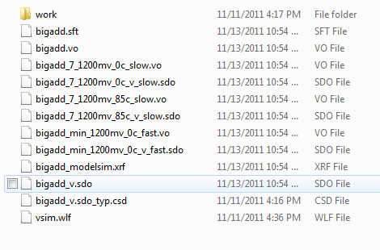
SDF Timing Information
// synopsys translate_off
initial $sdf_annotate("bigadd_v.sdo");
// synopsys translate_on

Slide 10
Demonstration
vlib work
vmap work work
vlog –work work timing.vo
vlog –work work timingtb.v
vsim –t ps +transport_int_delays
+transport_path_delays
–L work –L altera_ver –L cycloneive_ver
timingtb

