Slide 1
Synthesis of Memories in FPGA
Patrick Schaumont

Slide 2
Overview
Design flow for Datapath and Memory Elements
  Inference and instantiation
  Integrated synthesis and simulation
Memory Elements
  Register Files
  SRAM in Cyclone V E FPGA

Slide 3
Design flow for datapath & memory elements
Automatic Selection of
Library Components
(by matching
a Verilog language pattern)
RTL Verilog
Manual Selection of
Library Components
(by matching a module type name)
Inference
Instantiation
Macro's
Elements which can be
expanded in terms of primitives
Libraries
Primitives
LUT2 L(O, I1, I2);
Netlist
Elements directly available
in the FPGA fabric
Bitstream
FPGA
fabric
LUT2
MULT
BRAM

Slide 4
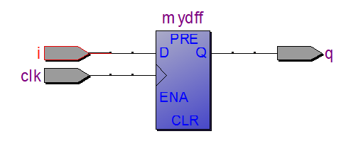
Example 1 (primitive): Flip-flop
This piece of code infers a flip-flop
module fsmdesign(input wire i, clk,
output reg q);
always @(posedge clk)
q <= i;
endmodule

Slide 5
Example 1 (primitive): Flip-flop
This piece of code instantiates a flip-flop
module fsmdesign(input wire i, clk,
output reg q);
dff mydff(i, clk, 1'b1, 1'b1, q);
endmodule
This is a primitive
library element

Slide 6


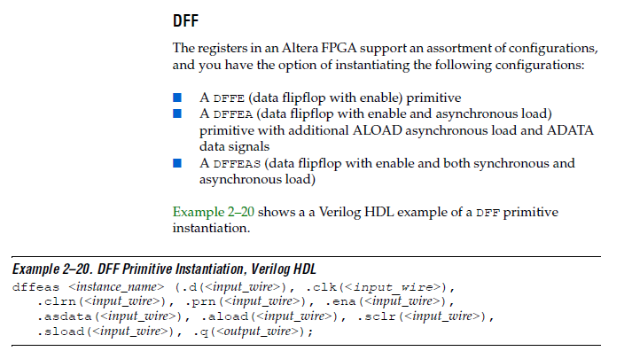
How do we know what primitives are available?

Slide 7
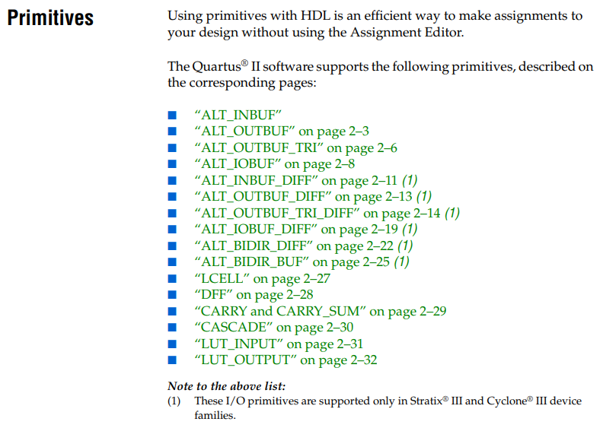
How do we know what primitives are available?

Slide 8
Inference vs Instantiation
Standard design practice (for any type of digital design: FPGA, ASIC) will mix inference and instantiation
Inference:
  Portable code which compiles on multiple targets
  Portable code which simulates with generic simulator
  Provides maximal freedom to synthesis tools
Instantiation:
  Nonportable code which makes specific assumption on target
  Nonportable code which requires simulation library to simulate
  Gives designer maximum control over synthesis process

Slide 9
Integrated Synthesis and Simulation
Once we use design elements from a library, we need to add a simulation library specific to the target technology
  Simulation library may provide a behavioral model of primitives and macro's, to implement the leaf cells of your design
In addition, after synthesis, additional design details help to estimate precisely the delay incurred by each component and each net. This can also be included in the simulation.
  Simulation library may provide detailed structural model of primitives, which are decorated with delay figures from tools.

Slide 10
Overview
Design flow for Datapath and Memory Elements
  Inference and instantiation
  Integrated synthesis and simulation
Memory Elements
  Register Files
  SRAM in Cyclone V E FPGA

Slide 11
Memory Elements: Register Files
Used when multiple registers are attached to single bus
May be multi-ported and/or concurrent read/write
write
address
R1
read
address
R2
write
data
read
data
R3
write
address2
MUX
read
address2
additional
write ports
R4
additional
read ports
write
data2
read
data2
How to implement this ?

Slide 12
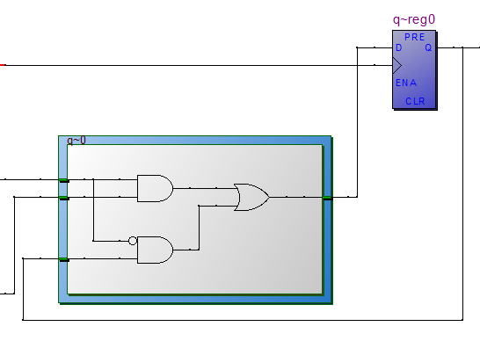
Memory Elements: Register Files
Single write-port : load-enable edge-triggered reg
write
address
decoder
enable
write
data
R1
module r1(q, clk, enable, in);
output [7:0] q;
reg [7:0] q;
input clk, enable;
input [7:0] in;
always @(posedge clk)
if (enable)
q <= in;
endmodule

Slide 13
Memory Elements: Register Files
How to implement dual write-port ?
write
address2
write
address1
enable
write
data2
R1
write
data1

Slide 14
Memory Elements: Register Files
Dual write-port : load-enable edge-triggered reg, mux and priority
write
address2
decoder
write
address1
decoder
write
data2
enable
0
R1
write
data1
1
What is the (most likely) critical path of this design ?

Slide 15
Memory Elements: Register Files
Dual write-port : load-enable edge-triggered reg, mux and priority
write
address2
decoder
write
address1
decoder
write
data2
enable
0
R1
write
data1
1
What is the (most likely) critical path of this design ?
Multi-port registers are slower than single-port registers

Slide 16
Overview
Design flow for Datapath and Memory Elements
  Inference and instantiation
  Integrated synthesis and simulation
Memory Elements
  Register Files
  SRAM in Cyclone V E FPGA

Slide 17
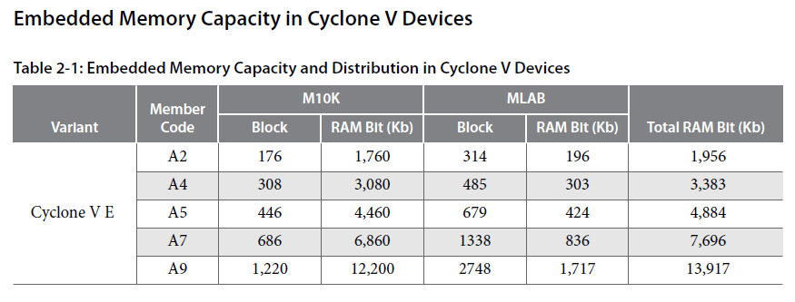
Memory Modules in Cyclone V

Slide 18
Inferring RAM in Verilog
// default: single-port synchronous RAM
module my_ram (clk, en, we, addr, di, do);
input clk;
input we;
input en;
input [5:0] addr;
input [15:0] di;
output [15:0] do;
reg [15:0] RAM [63:0]; // 16-bit, 64 locations
reg [15:0] do;
always @(posedge clk)
begin
if (en)
begin
if (we)
RAM[addr]<=di;
do <= RAM[addr];
end
end
endmodule

Slide 19
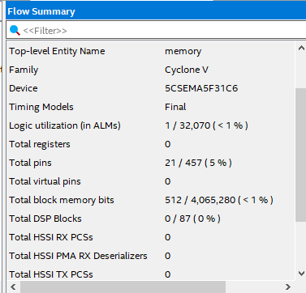
Inferring RAM in Verilog
// default: single-port synchronous RAM
module my_ram (clk, en, we, addr, di, do);
input clk;
input we;
input en;
input [5:0] addr;
input [15:0] di;
output [15:0] do;
reg [15:0] RAM [63:0]; // 16-bit, 64 locations
reg [15:0] do;
always @(posedge clk)
begin
if (en)
begin
if (we)
RAM[addr]<=di;
do <= RAM[addr];
end
end
endmodule
check your expectations

Slide 20
Inferring RAM in Verilog
// default: single-port synchronous RAM
module my_ram (clk, en, we, addr, di, do);
input clk;
input we;
input en;
input [1:0] addr;
input [15:0] di;
output [15:0] do;
reg [15:0] RAM [3:0]; // 16-bit, 4 locations
reg [15:0] do;
always @(posedge clk)
begin
if (en)
begin
if (we)
RAM[addr]<=di;
do <= RAM[addr];
end
end
endmodule

Slide 21
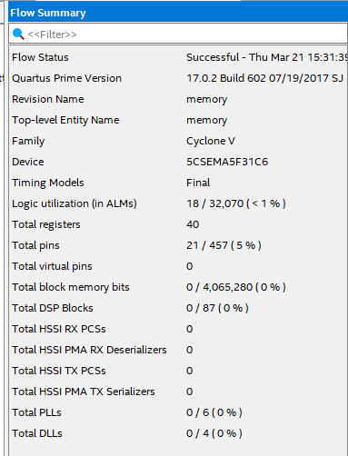
Inferring RAM in Verilog
// default: single-port synchronous RAM
module my_ram (clk, en, we, addr, di, do);
input clk;
input we;
input en;
input [1:0] addr;
input [15:0] di;
output [15:0] do;
reg [15:0] RAM [3:0]; // 16-bit, 4 locations
reg [15:0] do;
always @(posedge clk)
begin
if (en)
begin
if (we)
RAM[addr]<=di;
do <= RAM[addr];
end
end
endmodule
no block memory!

Slide 22
What if we use asynchronous RAM read ?
// default: single-port synchronous RAM
module my_ram (clk, en, we, addr, di, do);
input clk;
input we;
input en;
input [5:0] addr;
input [15:0] di;
output [15:0] do;
reg [15:0] RAM [63:0]; // 16-bit, 64 locations
wire [15:0] do;
always @(posedge clk)
begin
if (en)
begin
if (we)
RAM[addr] <= di;
end
end
assign do = RAM[addr];
endmodule

Slide 23
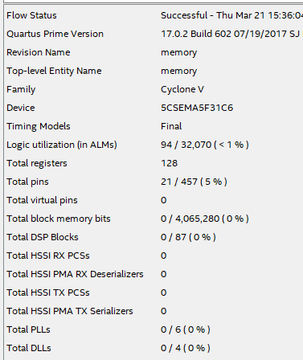
What if we use asynchronous RAM read ?
// default: single-port synchronous RAM
module my_ram (clk, en, we, addr, di, do);
input clk;
input we;
input en;
input [5:0] addr;
input [15:0] di;
output [15:0] do;
reg [15:0] RAM [63:0]; // 16-bit, 64 locations
wire [15:0] do;
always @(posedge clk)
begin
if (en)
begin
if (we)
RAM[addr] <= di;
end
end
assign do = RAM[addr];
endmodule
no block memory!

Slide 24
Dual-port RAM
module my_ram (clk, we, r_addr, w_addr, di, do);
input clk;
input we;
input [5:0] w_addr, r_addr;
input [15:0] di;
output [15:0] do;
reg [15:0] RAM [63:0]; // 16-bit, 64 locations
reg [15:0] do;
always @(posedge clk)
begin
if (we)
RAM[w_addr] <= di;
do <= RAM[r_addr];
end
endmodule

Slide 25
Initialized RAM
An initialized RAM can be used as a lookup table or as a ROM
In FPGA, bitstream specifies the initial contents of the M10K
In Verilog, we may specify the initial contents of the RAM in diffferent ways
  using initial block (inference) or synthesis constraints (instantiation)
  using $readmemb or $readmemh system calls
The tools will then ensure that the RAM will be initialized to the specified state after configuration

Slide 26
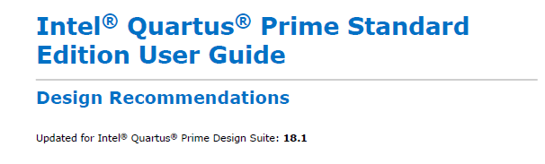
Finding how to write HDL for memory

Slide 27
Overview
Design flow for Datapath and Memory Elements
  Inference and instantiation
  Integrated synthesis and simulation
Memory Elements
  Register Files
  SRAM in Cyclone V E FPGA

